Slide 1
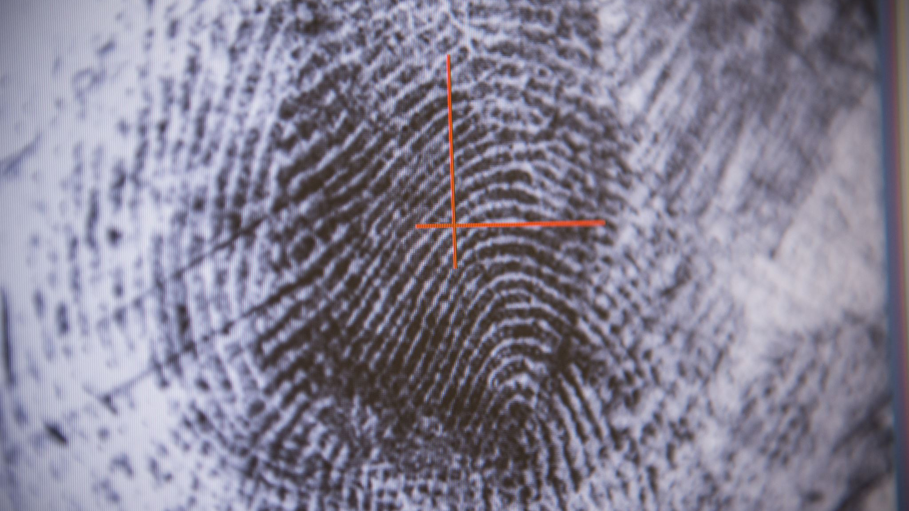

Deep Learning for Fingerprint Liveness Detection
-Manish Chowdary Ravipati

Slide 2
Introduction
Fingerprint liveliness detection is a security measure used to verify that the fingerprint being presented for authentication belongs to a live person and not a fake or copied fingerprint.
This process is designed to prevent fraud and improve security in applications such as border control, financial transactions, and access control systems.
Different techniques, including optical coherence tomography, pressure detection, thermal imaging, and capacitive sensing, are used to ensure the accuracy of fingerprint liveliness detection.

Slide 3
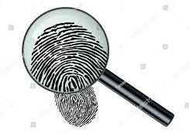
Why is it Important ?
Helps to prevent fraud and enhance security in various applications.
Without liveliness detection, it is possible for someone to use a fake or copied fingerprint to gain access to a secure system or complete a financial transaction.
By verifying that a fingerprint belongs to a live person, the system can ensure that only authorized individuals are granted access.
This can improve the accuracy and reliability of biometric systems, which can help to increase public confidence in these technologies.

Slide 4
Live/Fake Fingerprints:
Live fingerprints are the actual prints of a person's finger that are obtained when the finger is placed on a fingerprint scanner. Live fingerprints contain unique patterns of ridges, whorls, and arches that are used to identify individuals in biometric authentication systems.
Fake fingerprints, on the other hand, are artificial imitations of real fingerprints that are created to bypass biometric authentication systems. They can be made using a mold of a real fingerprint, a high-quality printout of a fingerprint, or a gelatin-based replica of a fingerprint.

Slide 5
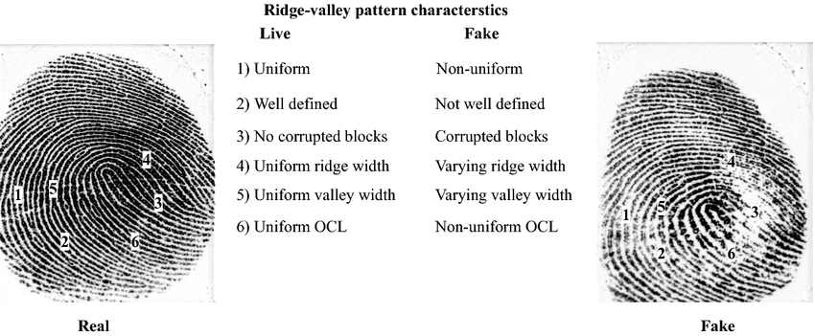
Difference in Live and Fake
Source = https://www.researchgate.net/figure/Ridge-valley-characteristics-of-the-live-and-fake-fingerprint-image_fig4_329686205

Slide 6
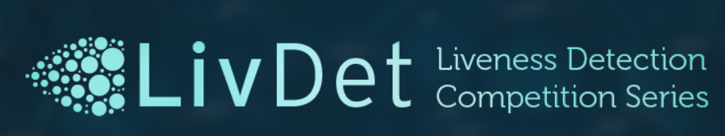
Dataset Used:
LivDet2015
Under this we have multiple Files, Here I am using Digital Persona.
It is classified into Training and Testing.
Under this there is another subfolder for Live and Fake.
Training_Live : 1000 images
Training_Fake : 250 images
Testing_Live : 1000 images
Testing_Fake : 250 images
Source: https://livdet.org/registration.php

Slide 7
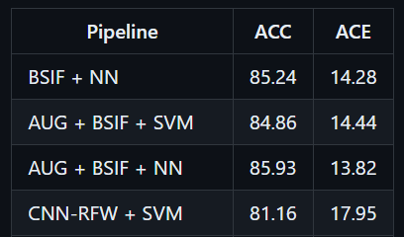
Existing Approaches:
SVM with BSIF/LPQ/WLD Features:
Features generated separately for the whole dataset.
SVM models trained and tested independently.
Parameters selected using cross-validation.
SVM with CNN-RFW Features:
SVM classifiers trained on CNN-RFW features.
Simple Neural Network with BSIF/WLD/LPQ Features:
Dimensionality reduction (PCA) applied to extracted features.
Multi-layer neural network models trained on reduced features.
SNN-MixFeat model merges SNN-BSIF, SNN-WLD, and SNN-LPQ models.
Source: https://github.com/splinter89/fingerprint-liveness-detection

Slide 8
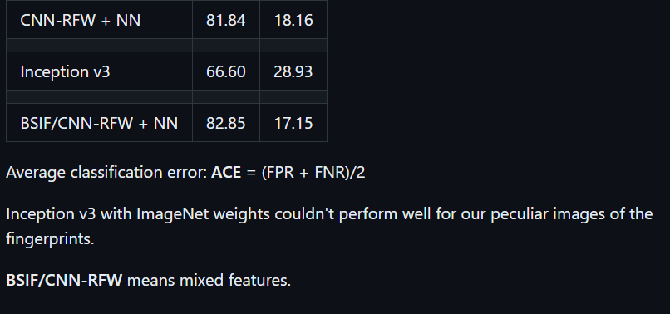
Neural Network with CNN-RFW Features:
NN classifiers trained on features extracted via Convolutional Neural Network.
Neural Network with CNN-RFW and BSIF Features:
Two feature sets concatenated via Merge layer.
NN classifier may take advantage of using multiple feature sets simultaneously.
Inception v3:
Pre-trained model used with a custom classifier block on top.
Fully connected layer with ReLU activation, dropout layer with standard rate 0.5, and a single output with sigmoid activation.
Source: https://github.com/splinter89/fingerprint-liveness-detection

Slide 9
Proposed Approach by using DL Model - ResNet 101:
It is a deep neural network architecture consisting of 101 layers
Pre-trained on the large-scale ImageNet dataset for image classification
Key innovation: residual connections that allow the model to learn residual mappings, improving training and mitigating vanishing gradients
Can be used as a feature extractor or fine-tuned on a new dataset for improved performance
Achieved state-of-the-art results on a variety of computer vision tasks, including image classification, object detection, and semantic segmentation

Slide 10
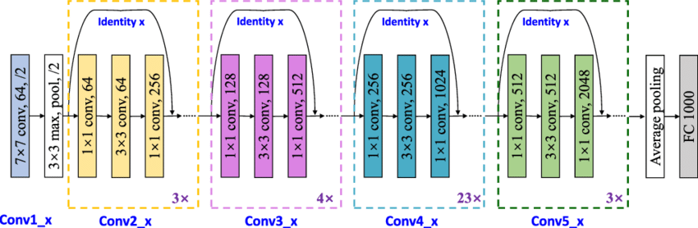

Slide 11
Data Augmentation:
Horizontal flip, crop 5+5 patches
Using translation and flipping operations
The flipping operation is done for each image, creating a new set of patches for the flipped image.
The resulting set of images in the target directory contains a total of 10 times the original number of images (5 patches for each of the original image and its flipped version).
Here I used Augmentation for Training Images. (i.e., T= Ti +10xTi)
Now I have Training_Live : 11,000 images and Training_Fake : 2750 images

Slide 12
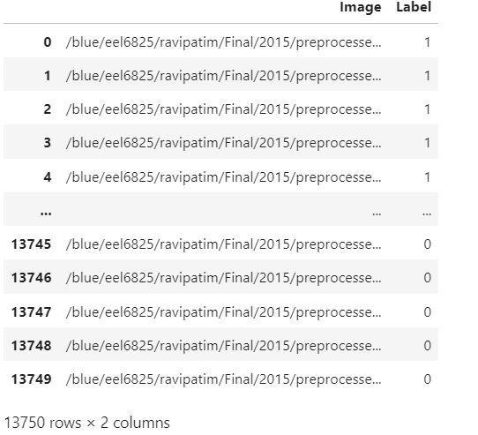
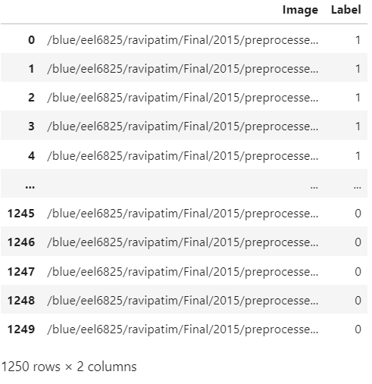
Data Pre-processing:
Labeling the data
Fake:0
Live:1
Used Color Inversion
Resized Image (300,300)
Training
Testing

Slide 13
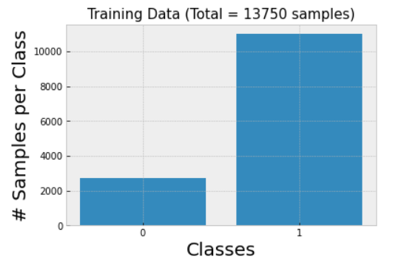
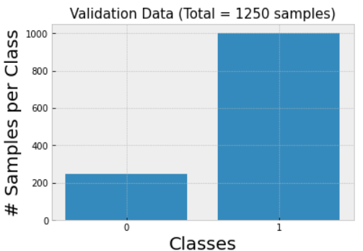
Testing and Validation:

Slide 14
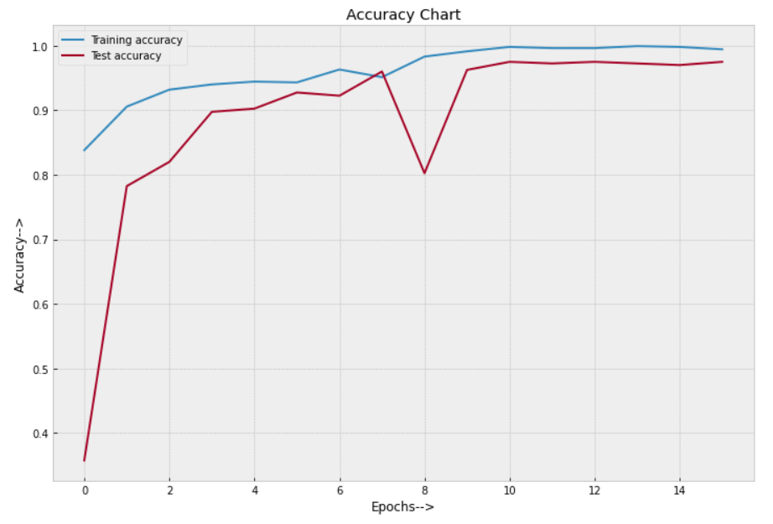
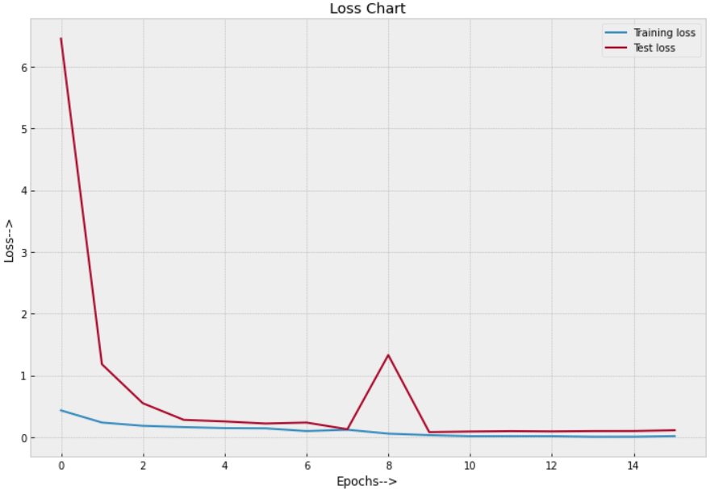
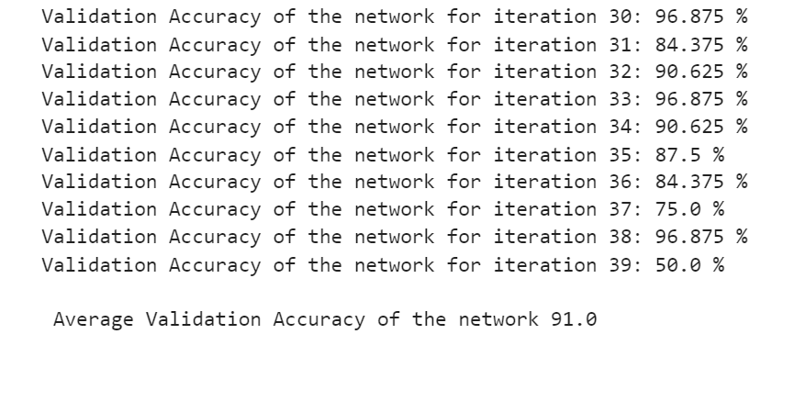
Results:
Accuracy Chart
Loss Chart
Average Validation Accuracy = 91.0%

Slide 15
Conclusion:
ResNet 101 outperformed the other methods with a validation accuracy of 91%.
ResNet's superior performance may be attributed to its deep architecture and skip connections, enabling it to better capture image features and learn complex representations.
S.no | Model | Validation Accuracy
1. | ResNet 101 | 91%.
2. | SVM + BSIF/LPQ/WLD | 85%
3. | SVM with CNN-RFW | 81%
4. | SNN + BSIF/WLD/LPQ | 86%
5. | Neural Networks + CNN-RFW | 82%
6. | NN+ CNN-RFW + BSIF | 83%
7. | Inception v3 | 67%

Slide 16

Thank you

